Slide 1

Pennant Technologies Private Limited
Concurrent Collections in Java

Slide 4
Need of Concurrent Collections:
In the Collection framework most of the Collection classes are not thread-safe because those are non-synchronized.
Like ArrayList, LinkedList, HashMap is non-synchronized in nature. If multiple threads will perform any operation on an object simultaneously.
Then the data will not be in proper synchronized and leads to data redundancy.
We can’t modify the collection while iterating the Collection object. If we try to modify the collection, it throws ConcurrentModificationException.
So non-synchronized collections are not good choice for Multi-threaded applications.
To overcome these problems Java introduced a new feature in JDK 1.5 Version. It introduced some thread safe collections java.

Slide 5
Concurrent collections in java
Concurrent collections in java are designed and optimized specifically for synchronized multithreaded access.
These are the thread safe collections, and these are existing in java.util.concurrent package
Java concurrent collections were introduced in version 5 and part of the java.util.concurrent package.
Here java introduced some more classes that are designed for concurrent access from multiple threads.
For example, HashMap is non-synchronized class but ConcurrentHashMap class is synchronized hash-based Map implementation. Here we have some java Concurrent collection classes:
1. Immutable List in Java
2. CopyOnWriteArrayList in java
3. Immutable Set in Java
4. CopyOnWriteArraySet in java
5. ConcurrentHashMap in java

Slide 6
What is an immutable List in Java?
List provides some Classes like ArrayList that is growable Array that can increase or decrease the size itself when the modification is done by the user.
An immutable List is a type of List that is immutable. It means the immutable List is read-only.
You can’t modify the content of the immutable List after declaration. So an immutable list is threaded safe.
Advantages/Need of immutable list:
an immutable object will not change after the declaration. These objects are thread-safe by default.
Because multiple threads can read them only, they can’t change the object’s state. The same logic applies to an immutable List.
if the user tries to modify(add or remove from list ) the list then the compiler will throw UnsupportedOperationException.
The most common use case of an immutable set is in a multi-threaded environment. Multiple threads can share immutable set data without worrying about synchronization.

Slide 7
How does it work?
import java.util.List;
public class ImmutableListExample{
public static void main(String[] args) {
Student student1 = new Student(1, "MCA", "Ravi");
Student student2 = new Student(2, "BCA", "Ram");
Student student3 = new Student(3, "BCA", "Ravi");
//creating list by using of() method
List<Student> immutableList = List.of(student1, student2, student3);
for(Student s : immutableList) {
System.out.println("Rollno :" + s.getRollNo());
System.out.println("Class Name :" + s.getClassName());
System.out.println("Name :" + s.getName()); }
// Changing the class Name of rollno 2
immutableList.get(1).setClassName("MCA");
System.out.println("After make chnges of Rollno 2: "+ immutableList.get(1).getClassName()); } }
In an immutable list, the user can modify the object properties but not the object.
Let’s say you have an immutable list that stores the 5 students’ records.
Each student has a name, class, roll no, etc.You can change the name of the student, class name, and roll no.
But you can’t change the number of students in the immutable list (add or delete student).

Slide 8
Creating Immutable List in Java
You can create an immutable list in various ways.
1. By use of copyOf() method We can create ImmutableList
ImmutableList<E> copyOf(Collection<? extends E> elements)
It returns an immutable list that contains all the elements of the given list/collection. It will throw NullPointerException if any element is null in the given collection.
2. By using of() method of ImmutableList class we can create ImmutableList
ImmutableList<E> of()
It returns an immutable list containing the given element.
3. We can create ImmutableList by Using Of() method List Class in Java 9 Factory.
Please Note: This program can run only in Java 9. You need a Java 9 compiler to run them.
4. We can create ImmutableList by Using Builder() method
By use of the Builder() method, We can create a new ImmutableList or an ImmutableList can be created from an existing List or both.

Slide 9
The important concepts of Immutable List
If a user tries to modify the immutable List(add, delete and update elements in the List) then UnsupportedOperationException is thrown. Because you can’t modify an immutable List.
An Immutable List does not allow any null element. If a user tries to add null in the Immutable List the compiler will throw UnsupportedOperationException.
If a user tries to create an Immutable List with a null element, then the compiler will throw NullPointerException.
If the user is creating an ImmutableList from an existing List and change the existing List, then the changes don’t reflect on ImmutableList. Because we have created a copy of the existing list.

Slide 10
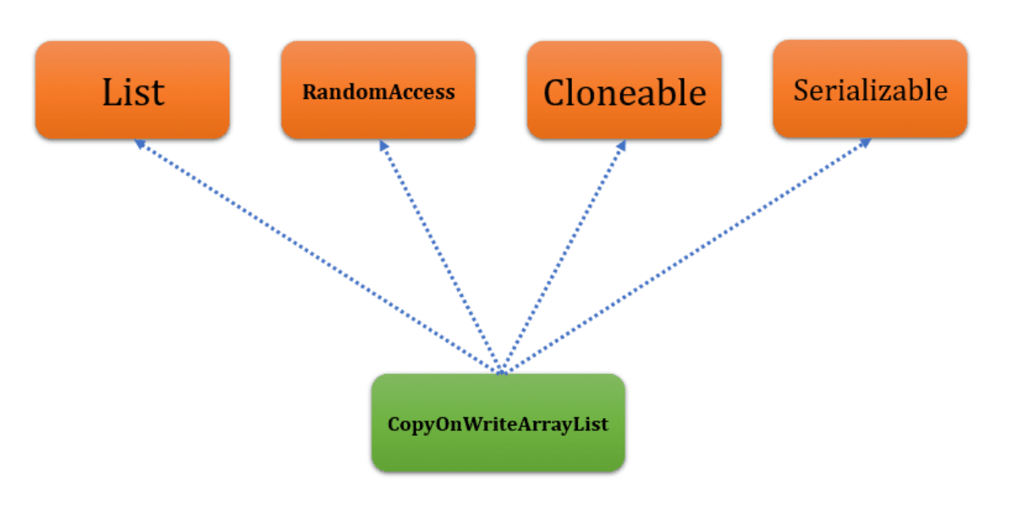
CopyOnWriteArrayList in java
The CopyOnWriteArrayList class is also part of the Java Collection framework which implements the List, Cloneable, RandomAccess, and Serializable interface.
A CopyOnWriteArrayList is similar to an ArrayList but it has some additional features like thread-safe. This class is existing in java.util.concurrent.

Slide 11
Important Points of CopyOnWriteArrayList in java
1. The CopyOnWriteArrayList is an enhanced version of ArrayList. If you are making any modifications(add, remove, etc.) in CopyOnWriteArrayList then JVM creates a new copy by use of Cloning.
2. The CopyOnWriteArrayList is costly if we want to update operations. Because whenever we make any changes the JVM creates a cloned copy of the underlying array and add/update element to it.
3. It is a thread-safe version of ArrayList. Multiple threads can read the data but only one thread can write the data at one time.
4. CopyOnWriteArrayList is the best choice if we want to perform read operation frequently.
5. The CopyOnWriteArrayList is a replacement of a synchronized List. Because it offers better concurrency when iterations outnumber mutations.
6. We can add duplicate elements in it and also heterogeneous Objects, but we should use generics to ignore compile-time errors.
7. In CopyOnWriteArrayList the removal operation of the Iterator is not supported. If you will try this it will throw a Run-time exception saying UnsupportedOperationException.

Slide 12
Constructors of CopyOnWriteArrayList in java
CopyOnWriteArrayList c = new CopyOnWriteArrayList();
It creates an empty list in memory.
This constructor is useful when you want to create a list without any value.
CopyOnWriteArrayList c = new CopyOnWriteArrayList(Collection obj);
It creates a list that containing all the elements that is specified collection.
This constructor is useful when you want to create a CopyOnWriteArrayList from existing collection.
CopyOnWriteArrayList c = new CopyOnWriteArrayList(Object[] obj) ;
It Creates a list that containing all the elements that is specified Array.
This constructor is useful when you want to create a CopyOnWriteArrayList from Array.

Slide 13
How does CopyOnWriteArrayList work internally?
The CopyOnWriteArrayList class using a mechanism in which every write operation (add, set, remove, etc) the JVM creates a new copy of the elements in the list. By use of this technique its thread-safe without a need for synchronization.
Let’s say we are adding some value in CopyOnWriteArrayList then JVM creates a new copy. Let’s have a look on code.
public boolean add(E e) {
synchronized (lock) {
Object[] es = getArray();
int len = es.length;
es = Arrays.copyOf(es, len + 1);
es[len] = e;
setArray(es);
return true; } }

Slide 14
How does CopyOnWriteArrayList work internally?
In add() method the write operation acquires a separate lock before executing a write operation, and all write operations use this same lock. It means only one thread can perform write operation at a time.
final void setArray(Object[] a) {
array = a;}
After that it gets the array and set to new array.
NOTE: As you know the read operations do not acquire any lock. It means multiple threads can perform read operations simultaneously. The read and write operations do not block each other.
When we are calling the iterator() and listIterator() method on the CopyOnWriteArrayList it returns an iterator object that holds immutable snapshot of the elements.
After creation of Iterator, if any other thread making changes in list that will not reflated in iterator object.
Due to this simple fact, we can iterate over the list in a safe way, even doesn’t care about the concurrent modification.

Slide 15
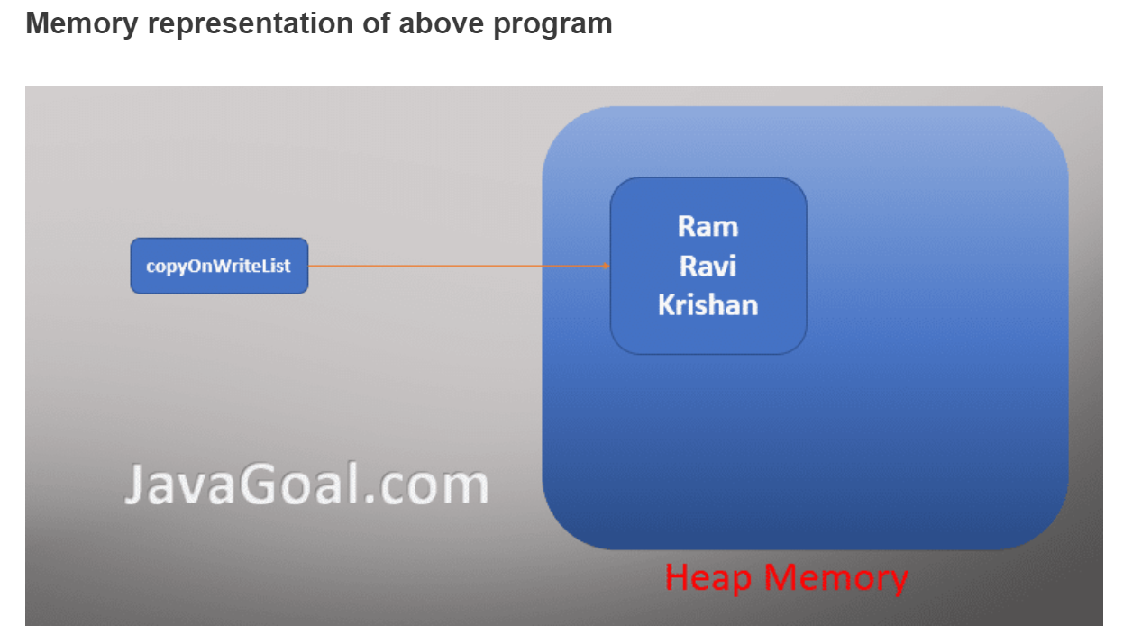
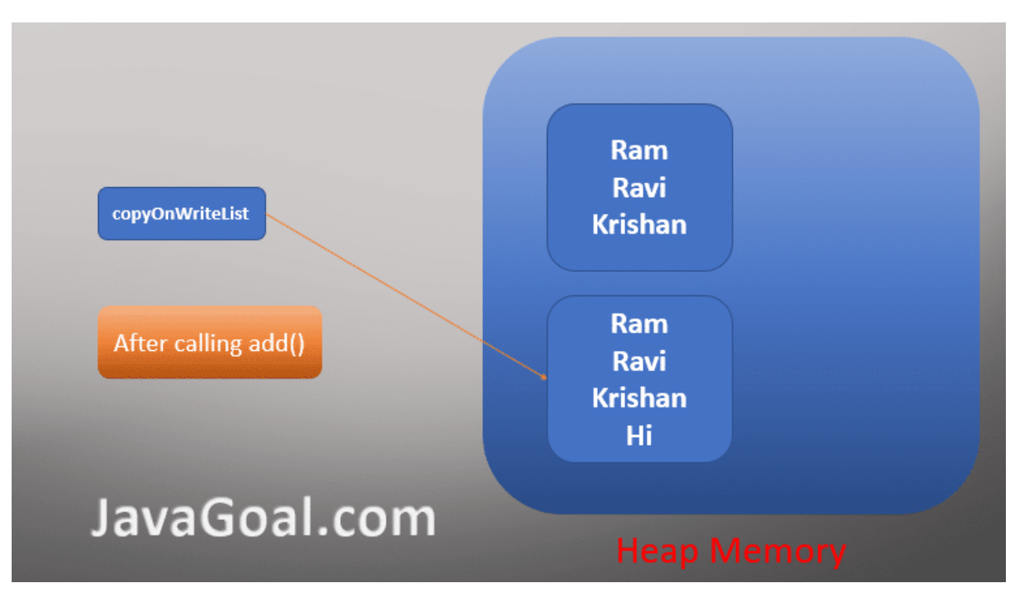

Slide 16
When to use CopyOnWriteArrayList or need of CopyOnWriteArrayList?
Whenever we are using concept in Java, we must thing when to use it or what is the need of concept. You should be aware the use case of CopyOnWriteArrayList.
We can use CopyOnWriteArrayList rather than the ArrayList for following cases
1. Thread safe
Note: In CopyOnWriteArrayList only one thread can perform write operation at a time But multiple threads can perform read operations simultaneously.
2. Minimum modification and frequently read operation
3. Don’t want to use synchronized ArrayList
Note: for more details refer this: https://javagoal.com/copyonwritearraylist-in-java/

Slide 17
What is an immutable Set?
The immutable Set can have a collection of objects like HashSet but we can’t modify the objects of the immutable set.
If we try to add or remove any object in immutable set it throws UnsupportedOperationException.
Need of the immutable set in java?
We can use the Immutable set when we have to work in a multithreading environment. As we have already discussed the immutable set is ready only.
Because if the user tries to modify(add or remove from Set) the immutable Set then the compiler will throw UnsupportedOperationException.
The most common use case of an immutable set is in a multi-threaded environment.
Multiple threads can share immutable set data without worrying about synchronization.
An immutable set, the user can modify the object properties but not the object.

Slide 18
How to Creating Immutable Set
1. By use of copyOf() method
ImmutableSet<E> copyOf(Collection<? extends E> elements)
It returns an immutable set that contains all the elements of the given list/collection. It will throw NullPointerException if any element is null in the given collection.
2. By use of() method we can create ImmutableSet
ImmutableSet<E> of()
It returns an immutable set containing the given element.
3. By Using Of() method in Java 9 Factory
Please Note: This program can run only in Java 9. You need a Java 9 compiler to run them.
4. By Collections.unmodifiableSet() method
First of all, create a HashSet object and initialize it with some values. After that, wrap it up with Collections.unmodifiableSet()

Slide 19
The important concepts of the Immutable Set
If a user tries to modify the immutable Set(add or delete elements in the Set) then UnsupportedOperationException is thrown. Because you can’t modify immutable Set
An Immutable Set does not allow any null element. If a user tries to add null in Immutable Set the compiler will throw UnsupportedOperationException.
If a user tries to create an Immutable Set with a null element, then the compiler will throw NullPointerException.
If the user is creating an Immutable Set from an existing Set and change the existing Set, then the changes don’t reflect on Immutable Set. Because we have created a copy of the existing Set.

Slide 20
CopyOnWriteArraySet in java
The CopyOnWriteArraySet class is part of the concurrent collection and it was introduced in JDK 1.5.
Some developer thinks ConcurrentHashSet in java but it’s not because there is nothing like in java ConcurrentHashSet.
The CopyOnWriteArraySet is thread-safe and it internally uses the CopyOnWriteArrayList for all of its operations.
A CopyOnWriteArraySet is a thread-safe HashSet in Java and it works like CopyOnWriteArrayList in java.
The CopyOnWriteArraySet internally used CopyOnWriteArrayList to perform all type of operation.
It means the CopyOnWriteArraySet internally creates an object of CopyOnWriteArrayList and perform operation on it.
Whenever we perform add, set, and remove operation on CopyOnWriteArraySet, it internally creates a new object of CopyOnWriteArrayList and copies all the data to the new object.
So, when it is used in by multiple threads, it doesn’t create a problem, but it is well suited if you have small size collection and want to perform only read operation by multiple threads.

Slide 21
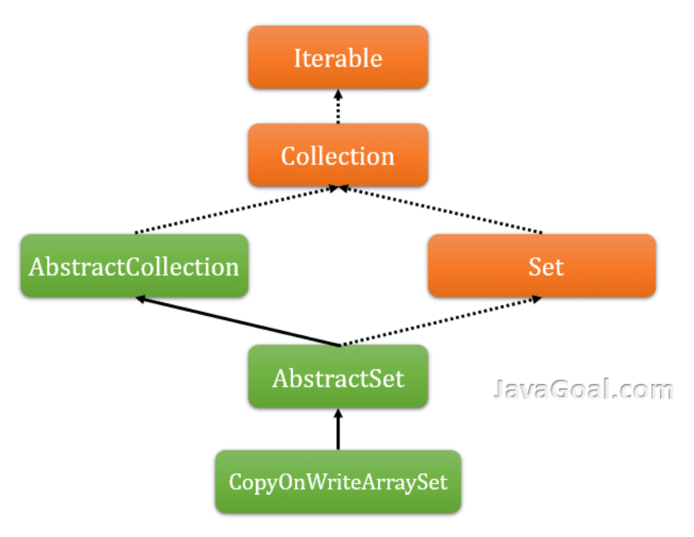

Slide 22
Important properties about CopyOnWriteArraySet ?
1. CopyOnWriteArraySet is a thread-safe variant of HashSet because whenever we perform any manipulation, it internally creates a new object and copies all the data to a new object.
2. It creates an object of CopyOnWriteArrayList internally and perform all the operations on it.
3. The CopyOnWriteArraySet is the best to use when we have only read operation in a multithreading environment because multiple threads can read it without creating a new copy.
4. The update operation is costly on CopyOnWriteArraySet because it creates a separate copy for each update operation5. The remove operation doesn’t support by Iterator and it will throw Run-time exception UnsupportedOperationException.
6. The CopyOnWriteArraySet is the replacement of synchronized Set and offers better concurrency when iterations outnumber mutations.
7. Because it creates a new copy of the underlying array every time iterator is created, performance is slower than HashSet.

Slide 23
How to create CopyOnWriteArraySet?
We can create CopyOnWriteArraySet through the use of Constructor.
The CopyOnWriteArraySet provides two constructors that are used to create CopyOnWriteArraySet. Both constructors internally create an object CopyOnWriteArrayList and perform an operation on the internal object.
Constructors of CopyOnWriteArraySet
CopyOnWriteArraySet(): It is the default constructor of CopyOnWriteArraySet class, and it creates an empty set. When we create a set by use of default constructor it internally invokes the default constructor of CopyOnWriteArrayList class.
CopyOnWriteArraySet(Collection c): It is the parameterized constructor of the CopyOnWriteArrayList class that accepts only one parameter of collection type.
It is used to create a set containing all the elements of specified collection.
If the collection contains duplicate elements, it accepts only unique elements. It throws NullPointerException if the given collection is null.

Slide 24
Method of CopyOnWriteArraySet
1. add(E e) method: The add(E e) method is used to add the given element in the set. It returns a boolean value. It returns false if the element already exists in the set.
2. addAll(Collection c): The addAll(Collection c) method is used to add the given collection in Set. It adds all the elements of the collection in the set. If any element already exists or duplicate in the collection, then it doesn’t add the element. It throws NullPointerException if the given collection is null.
3. remove(Object o): This method is used to remove the given element from the set. It returns false if the element doesn’t exist.
4. clear(): This method removes all of the elements from set.
5. contains(Object o): It is used to check whether the element exists in set ot not
6. isEmpty(): This method is used to check whether the set is empty or not? It returns a boolean value.
7. iterator(): It returns an object of iterator that contains all the elements of set.
8. int size() : It returns the number of elements present in the set.

Slide 25
ConcurrentHashMap in java
The ConcurrentHashMap is used in a multi-threaded environment to avoid ConcurrentModificationException.
The ConcurrentHashMap class extends AbstractMap class and implements the ConcurrentMap interface, Serializable interface also.
It was introduced in JDK 1.5.Like HashMap, ConcurrentHashMap provides similar functionality except that it has internally maintained concurrency.
It is the concurrent version of the HashMap. It internally maintains a HashTable that is divided into segments.
The number of segments depends upon the level of concurrency required the Concurrent HashMap.
By default, it divides into 16 segments and each Segment behaves independently.
It doesn’t lock the whole HashMap as done in HashTables/SynchronizedMaps, it only locks the particular segment of HashMap.

Slide 26


Slide 27
Important points about ConcurrentHashMap in java
1. The ConcurrentHashMap internally uses the HashTable as a data structure. Like Hashtable is threaded safe, but it provides all the functionality of HashMap except the thread-safe.
2. The ConcurrentHashMap internally divides the HashTable into segments. Each segment can work independently and access by a separate thread. It means different threads can perform operations on different segments.
3. In ConcurrentHashMap, the Object is divided into a number of segments according to the concurrency level. By default, it is divided into 16 segments.
4. ConcurrentHashMap allows multiple threads can perform read operation without locking the ConcurrentHashMap object.
5. It works based on segment locking or bucket locking. In ConcurrentHashMap multiple threads can perform retrieval operation but updating operation can be performed only by one thread. For updating operations, a particular segment must be locked.
6. It doesn’t allow null as key or value.

Slide 28
How to create ConcurrentHashMap?
To create a ConcurrentHashMap, we can use the constructors of ConcurrentHashMap class. There are a number of constructors that are used to create a ConcurrentHashMap. Let’s discuss all the constructors of the ConcurrentHashMap class.
constructors of ConcurrentHashMap class
1. ConcurrentHashMap() : It is the default constructor of ConcurrentHashMap class that creates an object of ConcurrentHashMap with default capacity 16. It has a default load factor 0.75 and a concurrency level is 16.
2. ConcurrentHashMap(int initialCapacity) : It is also used to create an empty ConcurrentHashMap with specified capacity. It has a default load factor and concurrency level is 16.
3. ConcurrentHashMap(int initialCapacity, float loadFactor): This constructor creates a ConcurrentHashMap with specified capacity and specified load factor. But it has default concurrency level is 16.
4. ConcurrentHashMap(int initialCapacity, float loadFactor, int concurrencyLevel): This constructor is used to create an object of ConcurrentHashMap with specified capacity, load Factor, and concurrency level.
5. ConcurrentHashMap(Map m): This method creates an object of ConcurrentHashMap with specified map. It copy all the objects from specified map to ConcurrentHashMap object.

Slide 29
ConcurrentHashMap internal working
Like HashMap and HashTable, the ConcurrentHashMap is also used to HashTable data structure.
But it is using the segment locking strategy to handle the multiple threads.
A segment is a portion of ConcurrentHashMap and ConcurrentHashMap uses a separate lock for each thread.
Unlike Hashtable or synchronized HashMap, it doesn’t synchronize the whole HashMap or HashTable for one thread.
As we have seen in the internal implementation of the HashMap, the default size of HashMap is 16 and it means there are 16 buckets.
The ConcurrentHashMap uses the same concept is used in ConcurrentHashMap.
It uses the 16 sperate locks for 16 buckets by default because the default concurrency level is 16.
It means a ConcurrentHashMap can be used by 16 threads at same time. If one thread is reading from one bucket(Segment), then the second bucket doesn’t affect it.

Slide 30
How does ConcurrentHashMap implementation increase performance?
The ConcurrentHashMap performs segment locking in a multithreading environment.
It allows performing read operations concurrently without any blocking.
It can perform retrieval operations and may overlap with update operations.
We can perform read operations by multiple threads at the same, but the only thread can perform updation operation at a time.
The read operations return the result updated by the most recently updated operations that mean the read operation may not fetch the current/in-progress value.
Memory visibility for the read operations is ensured by volatile reads.

Slide 31
Why we need ConcurrentHashMap in java?
As we know HashTable and HashMap works based on key-value pairs.
But why we are introducing another Map? As we know HashMap is not threaded safe, but we can make it thread-safe by using Collections.synchronizedMap() method and HashTable is thread-safe by default.
But a synchronized HashMap or HashTable is accessible only by one thread at a time because the object get the lock for the whole HashMap or HashTable.
Even multiple threads can’t perform read operations at the same time.
It the main disadvantage of Synchronized HashMap or HashTable, which creates performance issues.
So ConcurrentHashMap provides better performance than Synchronized HashMap or HashTable.
for more details refer this:
https://javagoal.com/concurrenthashmap-in-java/

